Slide 1
Contrasting SCW Posters Part 1

Slide 2
Notes:
2

Slide 4
Notes:
4

Slide 6
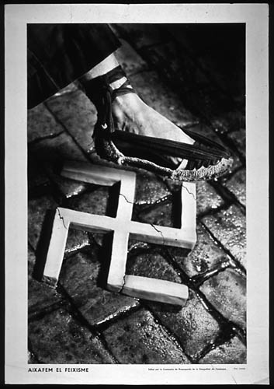
Notes:
6

Slide 7
Notes:
7

Slide 8
Notes:
8

Slide 9
Notes:
9

Slide 12
Notes:
12

Slide 13
Notes:
13

Slide 14
Notes:
14

