Slide 1
The Spanish Civil War
Historical Background

Slide 2
The Second Republic (1931-36)
1934-35: center-right government: undoes reforms
Oct ‘34: general strike; revolution in Asturias; repression; polarization
Left unites in Popular Front, wins Feb 36 elections
Army conspires: July coup
1931: Proclamation of Republic
1931-33: Liberal Republican gov’t: progressive reforms: social (divorce), labor (unemployment, work week), agrarian (fails), educational (secularization, alphabetization), political (regional autonomony)

Slide 3
New York Times, July 19 and 20, 1936

Slide 4
The European Context
[3-minute video clip from The Spanish Civil War, Granada Television: https://vimeo.com/78731313]

Slide 5
SCW as moral-political testcase: Impossible not to take sides.
“The equivocal attitude, the Ivory Tower, the paradoxical, the ironic detachment, will no longer do. … The question we are asking you: Are you for, or against, the legal Government and the People of Republican Spain? Are you for, or against, Franco and Fascism?”
Ad for Authors Take Sides, a Left Review pamphlet listing writers’ opinions on the Spanish Civil War

Slide 6
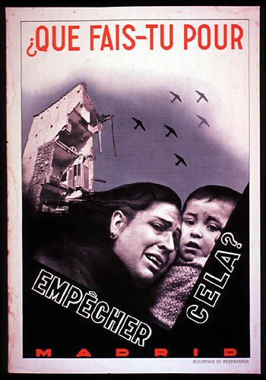
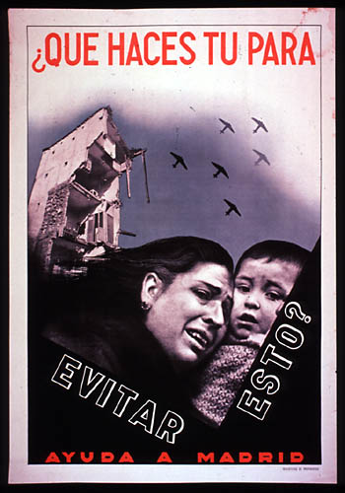

Slide 7
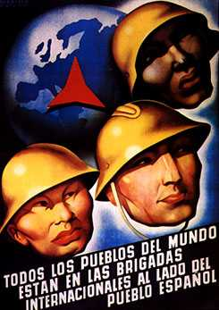
SCW: International Dimension
“Spanish” versions/manifestations of tensions that were playing out in Europe as a whole: economic depression; fascism-democracy-communism; different reactions towards, and conceptions of, modernity
“Non-Intervention Pact”: in practice dooms the Republic
Intervention: Germany, Italy, USSR
International Brigades: 35,000-40,000 total, 3,000 from the US: workers, students, intellectuals, men, women, white, Latino, African-American

Slide 8
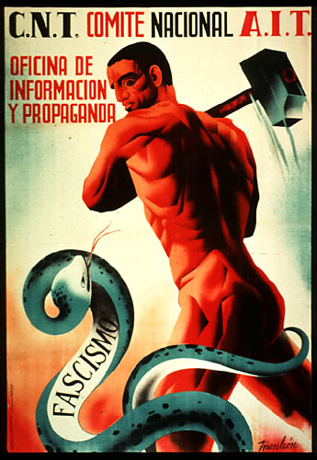
SCW: International Dimension
Spain becomes screen on which different groups and nations project their hopes and fears
Distortion/demonization/ idealization -- and, above all, simplification.
Propaganda: allegory: Good vs. evil (“Christian civilization” vs. “Communist hordes”; “democracy” vs. “fascism”)

Slide 9
SCW in the US
Proves extremely divisive
Images and reports of political & religious violence, and civilian victims preoccupy / mobilizes large segments of the population
Roosevelt hesitant; Congress adopts neutrality laws (no arms trade, no travel)
Labor, liberal left, liberal protestants, student movement favor the Republic and call for an end to the embargo
Business, catholic church favor Nationalists

Slide 10
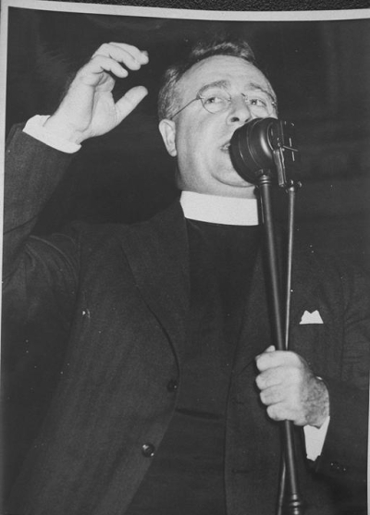
Pro-Franco Voices
Father Charles Coughlin, the “Radio Priest” (anti-Semitic, anti-immigrant, anti-Communist) [clip from The Good Fight, 50:50]

Slide 11
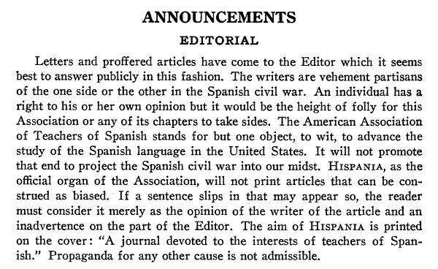
Editorial by Alfred Coester, Hispania, December 1936

