Slide 1
SCW: Domestic dimensions
Deeply rooted in long-term Spanish tensions and problems: agrarian problem; uneven development (industry, education); national identity crisis (1898, loss of empire); frustrated and top-heavy military; increasing frustration with lack of democracy and social justice (liberal middle classes, urban working class, landless laborers)
The two opposing camps were in reality make-shift coalitions made up of subgroups with very different, and often conflicting, ideas and ideals.

Slide 2
Republicans (Loyalists, rojos)
Liberal, middle-class, moderate Republican parties (anti-revolutionary, centralist)
Socialist party and its unions (internally divided: from revolutionary to reformist social democrat; centralist),
Anarchist unions (anti-authority, revolutionary, internationalist/localist)
Catalan and Basque nationalists
Communist Party (Stalinist; anti-revolutionary; internationalists)
Non-Stalinists Marxists (POUM; revolutionary)

Slide 3
Nationalists (Rebels, Francoists, fascistas)
The political Right: conservatives, traditionalists, monarchists, conservative catholics from all classes
Carlists (reactionary, monarchist Catholics)
Landholding and industrial elites
Army (obsessively centralist; imperialist ambitions)
Church (eager to hold on to its power; apalled by church burnings and priest killings)
Falangist (fascist) party (revolutionary, centralist, imperialist, anti-democratic)

Slide 4
SCW: nationalist dimensions
Catalan and Basque nationalist side with Republic (though they are politically diverse movements and not necessarily on the same page as the other factions in the Republican camp)
Both Republicans and Nationalists claim to represent the “true Spain,” portraying the enemy as “foreign” (either Asiatic/Communist/Jewish etc., or German/Italian/Fascist/imperialist etc.)

Slide 5
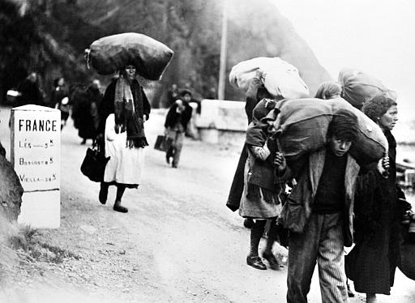
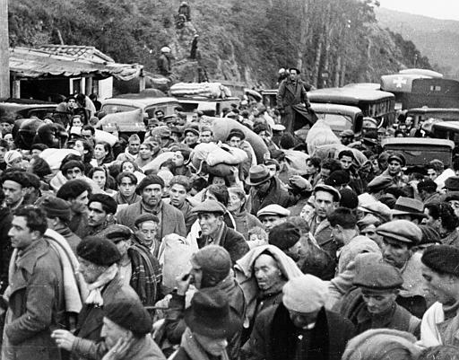
Victory / Defeat
April 1, 1939: Franco declares victory
Wants, and gets, unconditional surrender
500,000 in exile (French concentration camps; later Mexico, USSR, Argentina, US); Republican government in exile, in function until 1977
First large refugee crisis to be widely covered by visual media

Slide 6
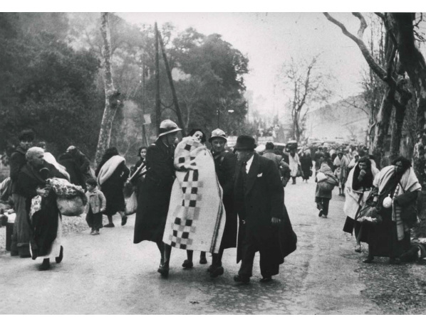
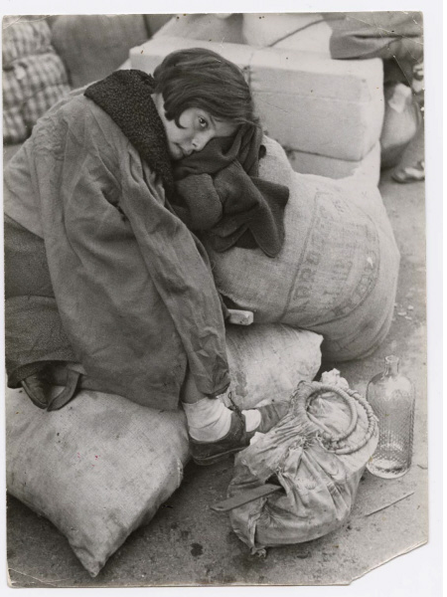
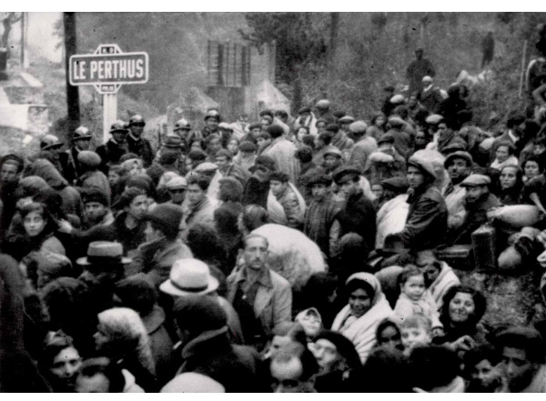
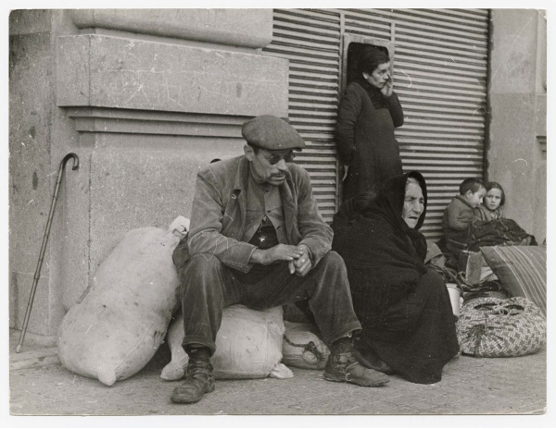

Slide 7
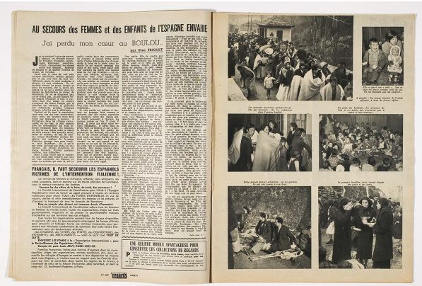
Regards, 9 Feb 1939

